Slide 1


Microsoft Movie Studio
One…Two… Three… Action!!
New Business Opportunity
Notes:
To change the image on this slide, select the picture and delete it. Then click the Pictures icon in the placeholder to insert your own image.

Slide 2
Problem Statement.
Microsoft sees all the big companies creating original video content and they want to get in on the fun. They have decided to create a new movie studio, but they don’t know anything about creating movies.
As a potentially new entrant to the market, what type of films are doing the best in the box office?

Slide 3
Objectives
Explore what types of films are currently doing the best at the box office.
Translate those findings into actionable insights that the head of Microsoft's new movie studio can use to help decide what type of films to create.

Slide 4
Number of Movies Released between the years 2010 and 2019
Number of movies released between the years 2010 to 2019 saw a steady rise.
However the year 2017 saw a sharp decrease in the movies released followed by a further decrease in 2018 and 2019.
The strengthening of on-demand movie streaming services such as Netflix played a role in the decrease in revenue in 2017 followed by the Covid-19 pandemic that began in 2019

Slide 5
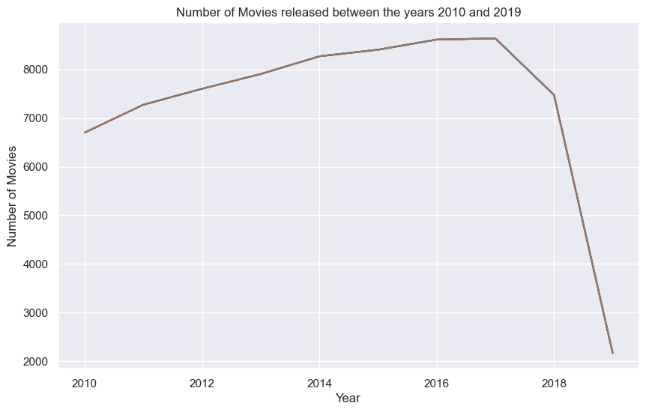
Number of Movies Released between the years 2010 and 2019

Slide 6
Average viewer weighted rating of movies released between year 2010 and 2019.
The average ratings and weighted rating of movies released between 2010 and 2019 saw a consistent increase from a low point in 2012 to the highest point in 2019

Slide 7
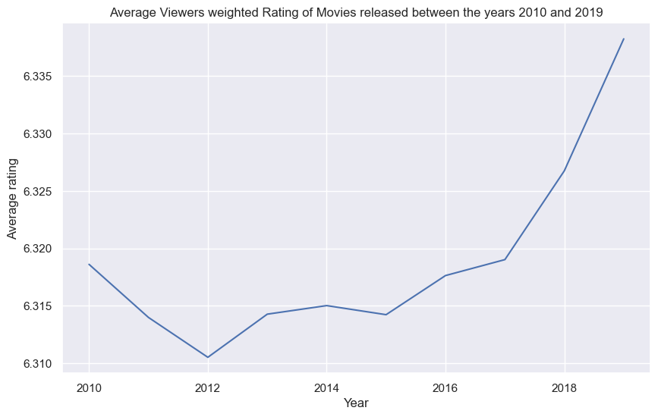
Average viewer weighted rating of movies released between year 2010 and 2019.

Slide 8
Average viewer weighted rating of movies released between year 2010 and 2019.

Slide 9
Top 10 Movie Genres
Drama, Documentaries, comedy, Thriller and Horror featured as the most popular movie genres that we released between 2010 and 2019.
Additionally, Reality-TV, Adult, Game-Show and Short genres feature the least released genres in the same period of time.

Slide 10
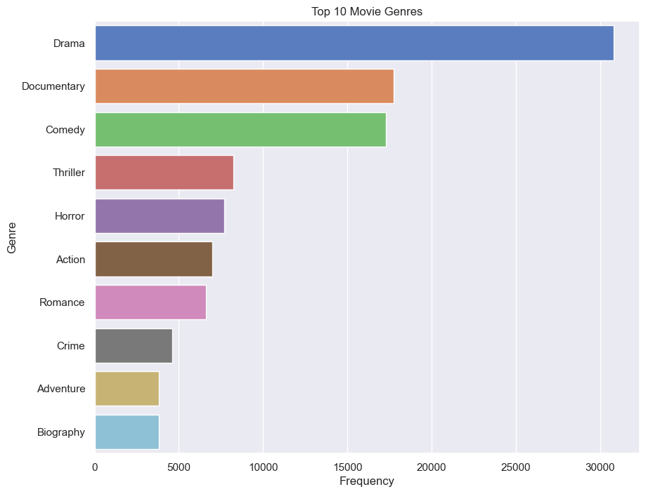
Top 10 Movie Genres

Slide 11
Findings and Recommendations.
Based on the analysis above, here is a summary of the findings:
1. Most popular genre of movies included Drama, Documentaries, comedy, Thriller and horror movies
2. Most profitable movies genres based on foreign gross income we action and drama
3. National disasters and pandemics can affect the revenues a movie can make upon launch
Based on the above observations, The following are our recommendations:
To build on the popularity on Microsoft's movie studio, Microsoft should initially produce Drama and Documentaries as the then to be popular
Action and Drama themed movies have the greatest potential of making profit for the soon to be established Microsoft Studio.
An on demand-movie streaming service that will allow for sharing of exclusive content to build on the popularity od the movie studio.
The average length of a movie is 94 minutes.

Slide 12
Thank You!

